Slide 1

Project: Comparison of Region Based on Sales
Akash Chauhan

Slide 2
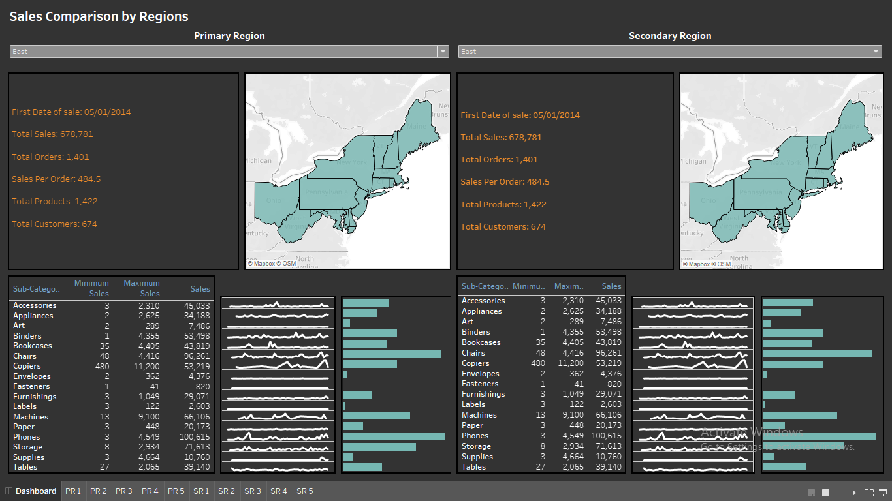

Slide 3
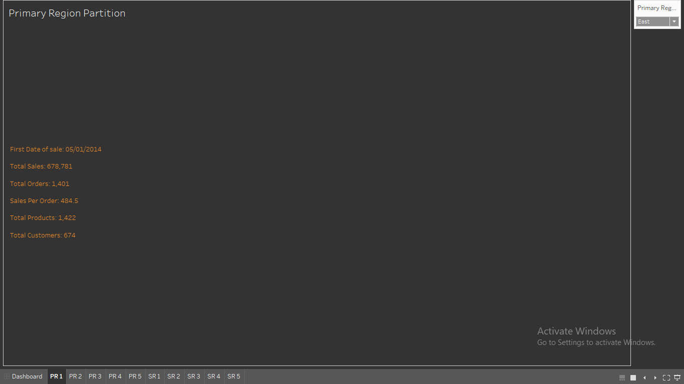

Slide 4
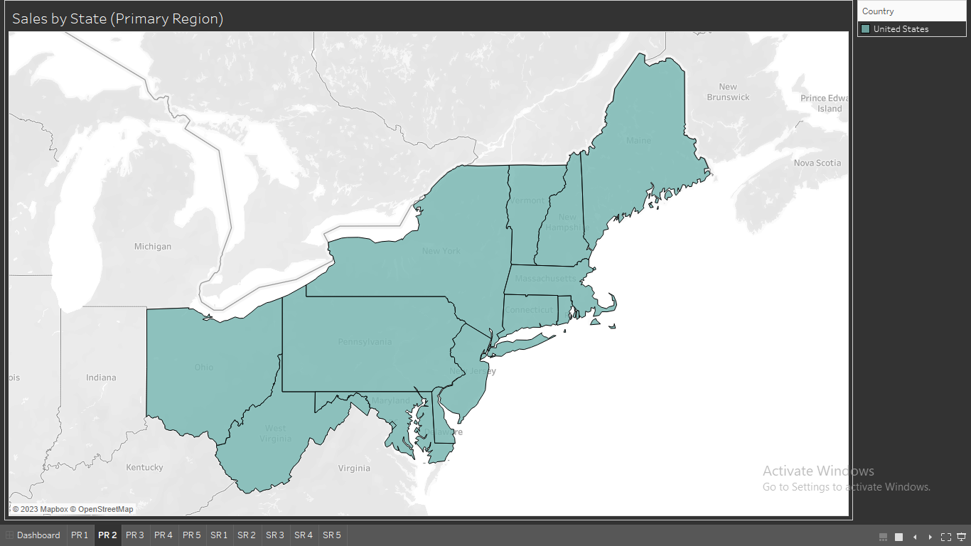

Slide 5
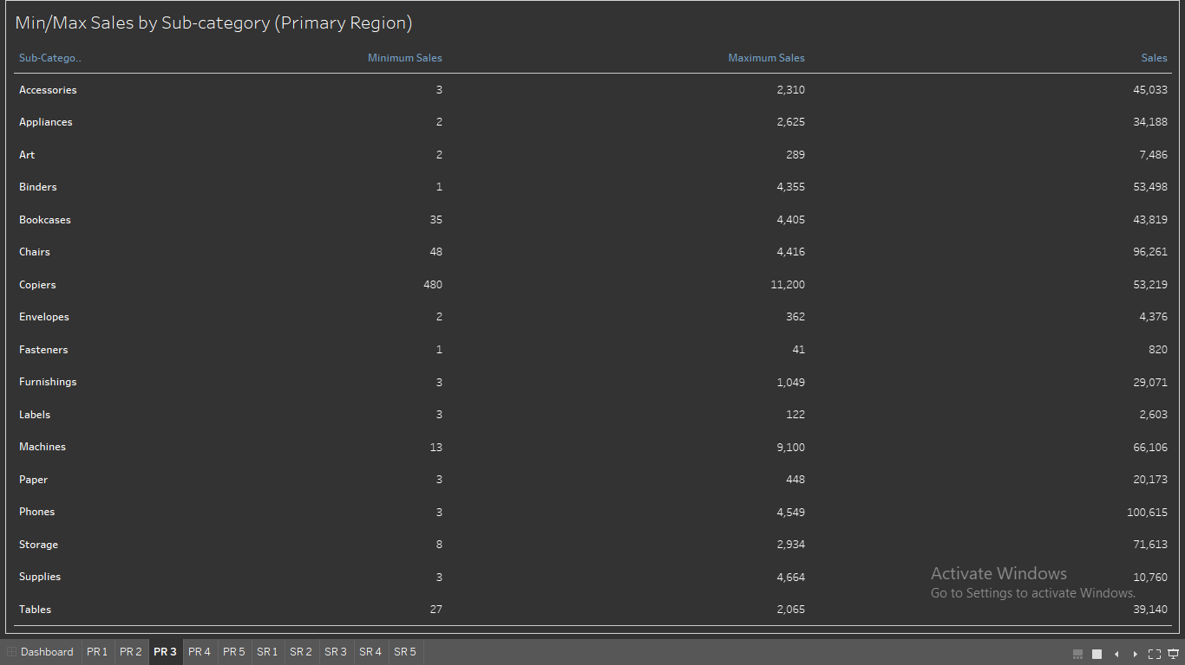

Slide 6
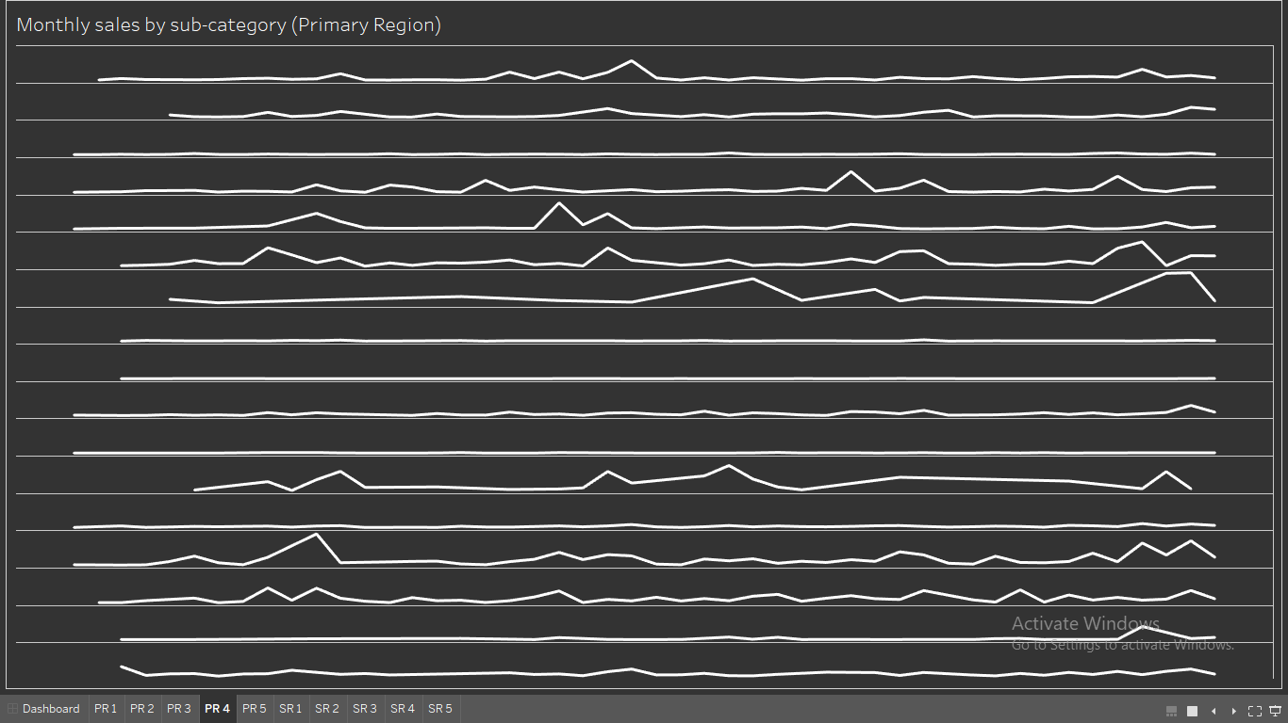

Slide 7
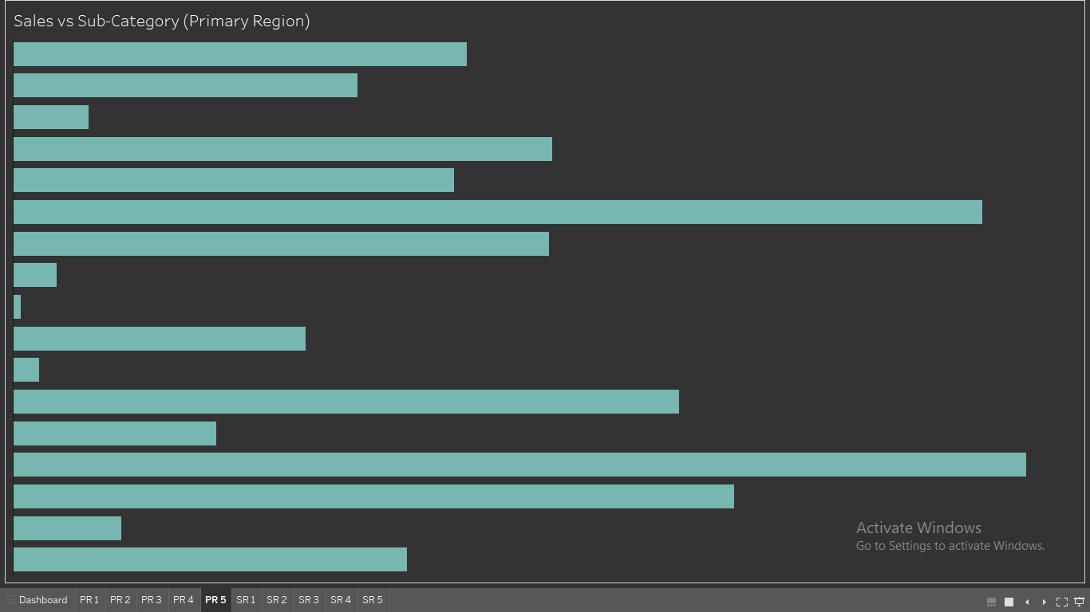

Slide 8
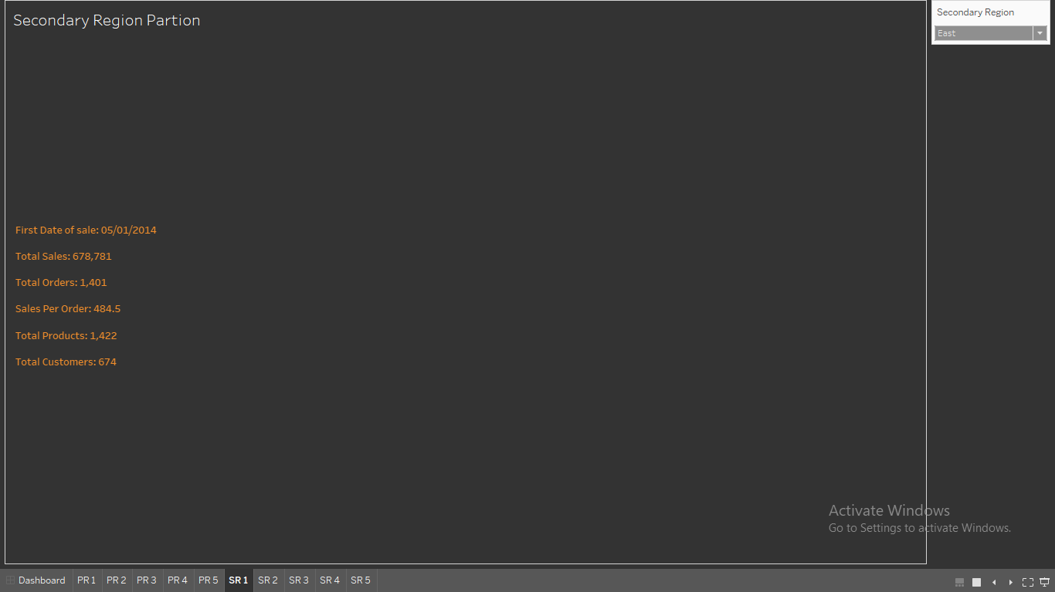

Slide 9
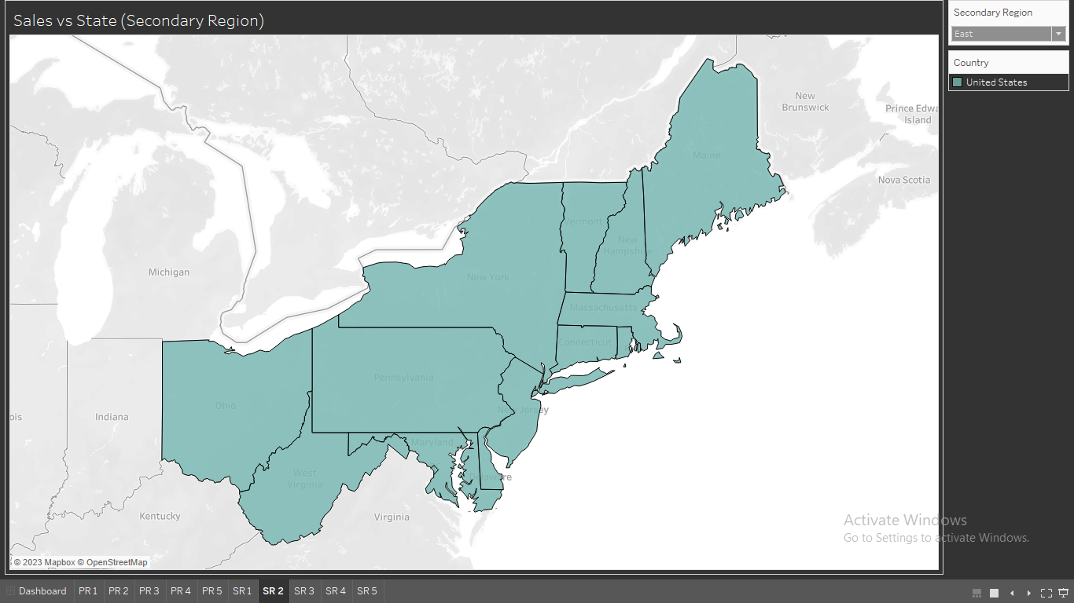

Slide 10
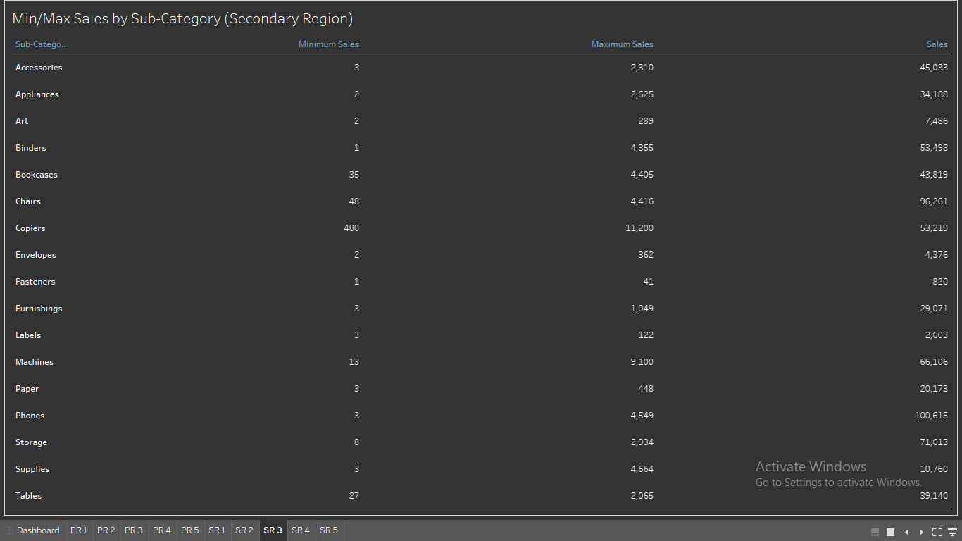

Slide 11
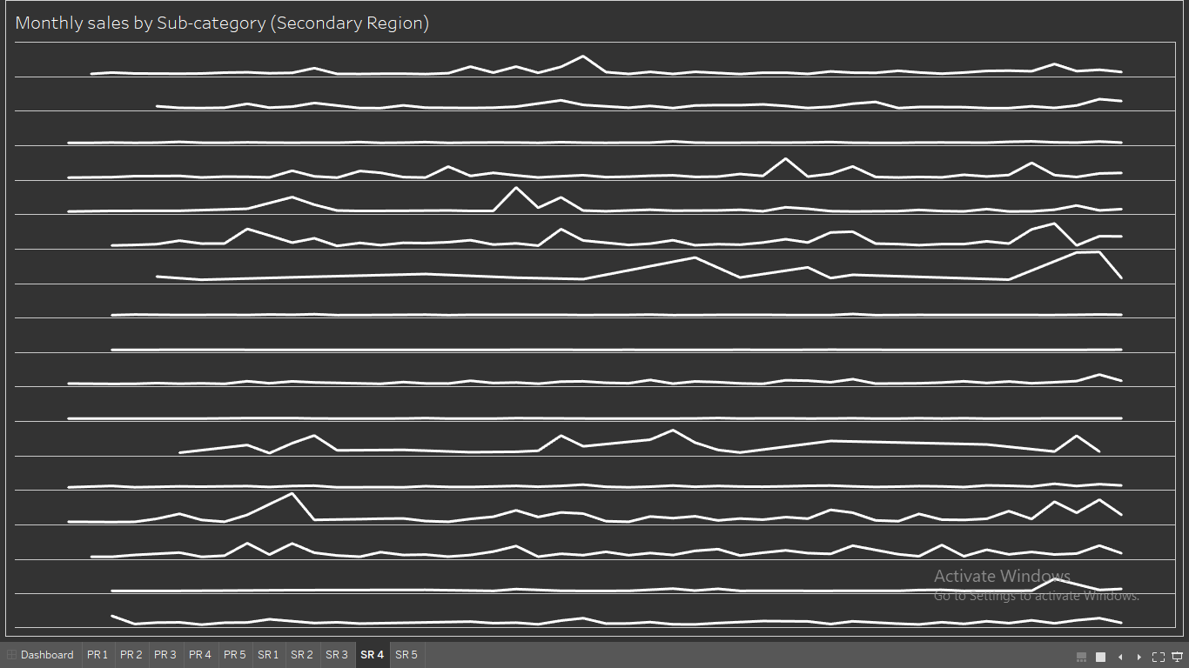

Slide 12
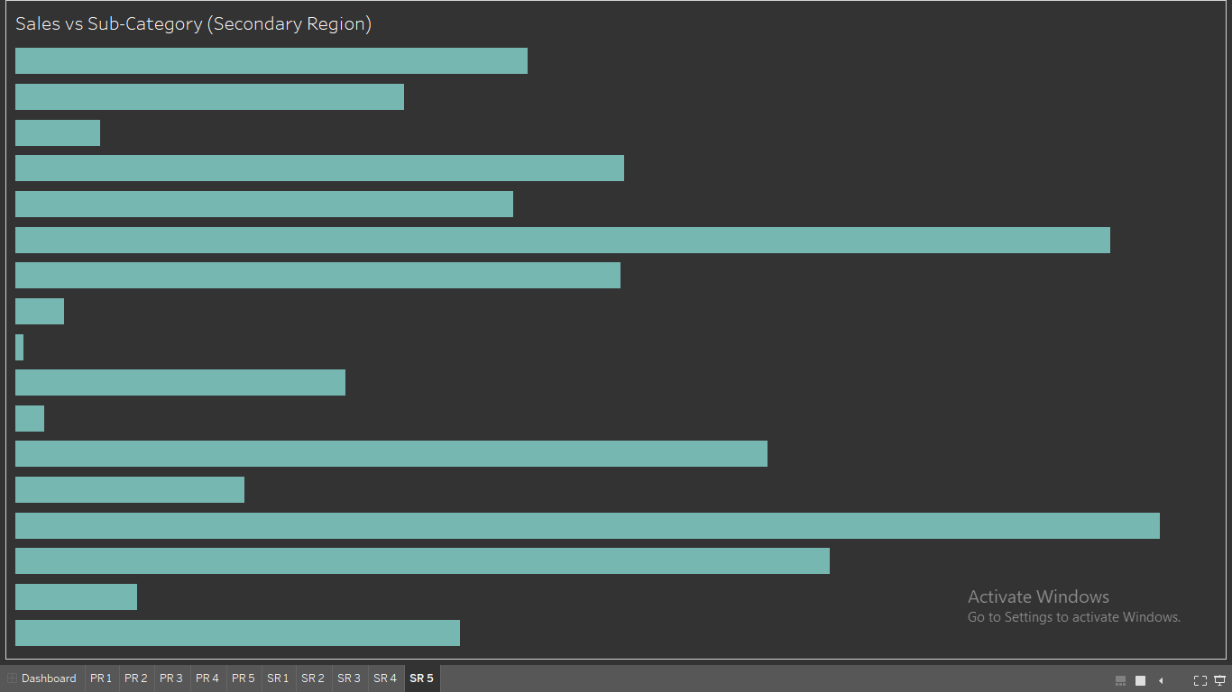

Slide 13


PROJECT OUTCOME
This project is designed to help create a dashboard to visualize the sales comparison between two selected regions.
In order to increase sales, the organization can take preventive measures using dashboards.

Slide 14
THANK YOU!

